Slide 1
Symmetric Distribution, Skewness, Kurtosis and KDE

Slide 2
Symmetric Distribution
Symmetrical distribution occurs when the values of variables appear at regular frequencies and often the mean, median, and mode all occur at the same point.
The uniform distribution is symmetric. The probabilities are exactly the same at each point.
In statistics, symmetric distribution is a distribution in which the left and right sides mirror each other.
The most well-known symmetric distribution is the normal distribution, which has a distinct bell shape.

Slide 3
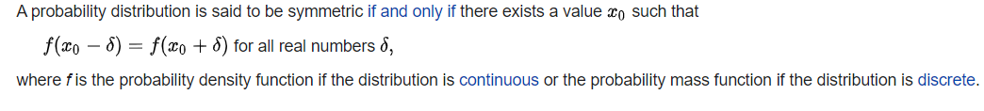
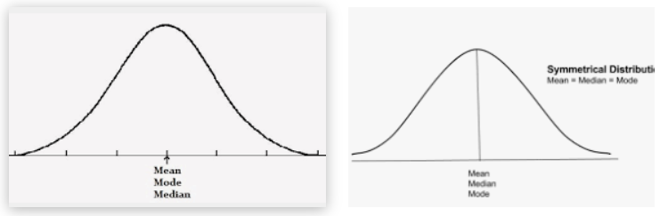
Symmetric Distribution- Formal definition

Slide 4
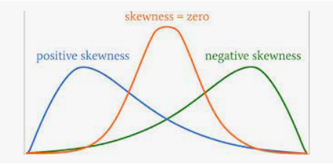
Skewness
Skewness measures the deviation of a random variable's given distribution from the normal distribution, which is symmetrical on both sides. A given distribution can be either be skewed to the left or the right.
Skewness is a measure of asymmetry or distortion of symmetric distribution. It measures the deviation of the given distribution of a random variable from a symmetric distribution, such as a normal distribution.

Slide 5
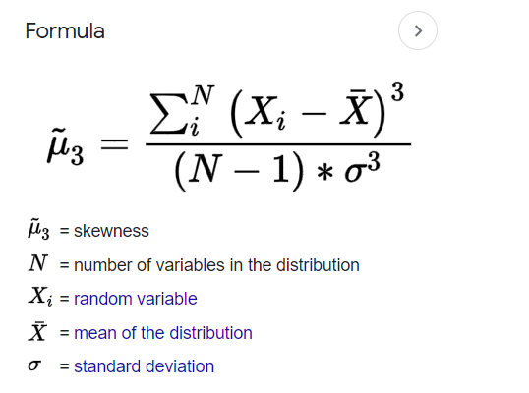
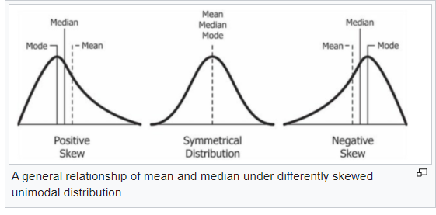
Skewness
Mean, Median and Mode in Skewed Chart

Slide 6
Why is Skewness Important?
First, linear models work on the assumption that the distribution of the independent variable and the target variable are similar. Therefore, knowing about the skewness of data helps us in creating better linear models

Slide 7
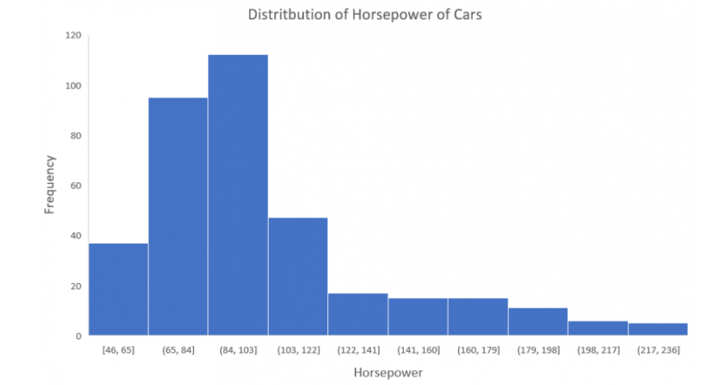
Why is Skewness Important?
You can see that the distribution is positively skewed. Now, let’s say you want to use this as a feature for the model which will predict the mpg (miles per gallon) of a car
Since our data is positively skewed here, it means that it has a higher number of data points having low values, i.e., cars with less horsepower.
So when we train our model on this data, it will perform better at predicting the mpg of cars with lower horsepower as compared to those with higher horsepower.

Slide 8
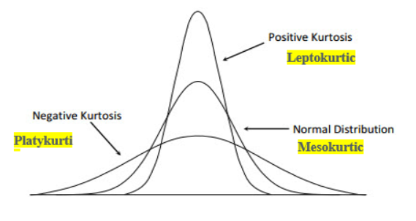
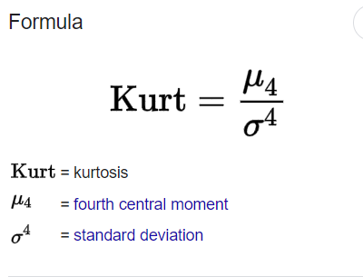
Kurtosis
Kurtosis is a statistical measure that defines how heavily the tails of a distribution differ from the tails of a normal distribution.
In other words, kurtosis identifies whether the tails of a given distribution contain extreme values.
Kurtosis is a statistical measure, of whether the data is heavy-tailed or light-tailed in a normal distribution.

Slide 9
Kurtosis

Slide 10
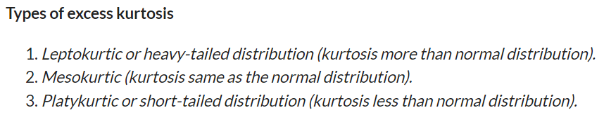
Types of Kurtosis
Excess Kurtosis
normal distributions have a kurtosis of 3, excess kurtosis is calculated by subtracting kurtosis by 3.
Excess kurtosis = Kurt – 3

Slide 11
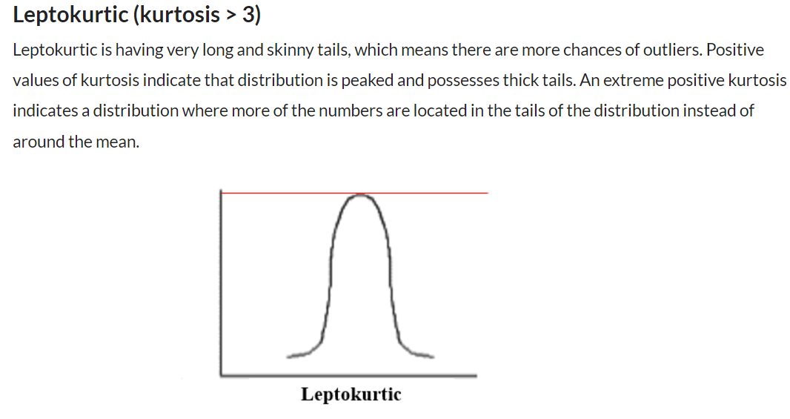

Slide 12
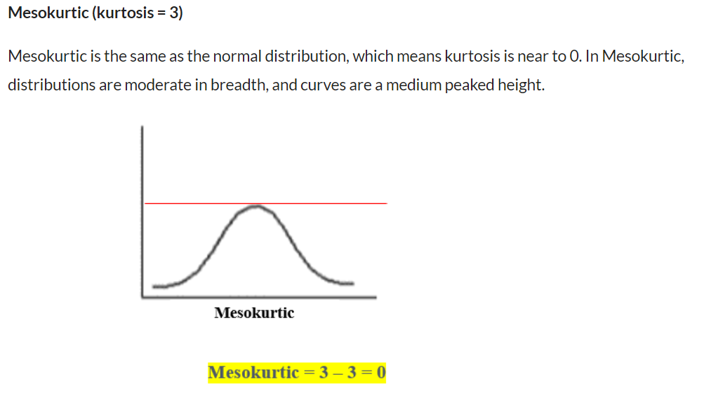

Slide 13
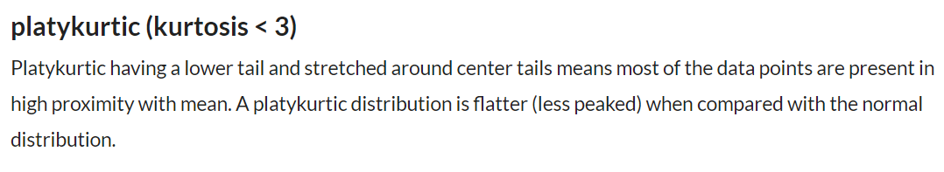
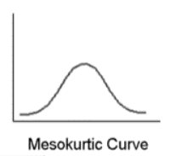

Slide 14
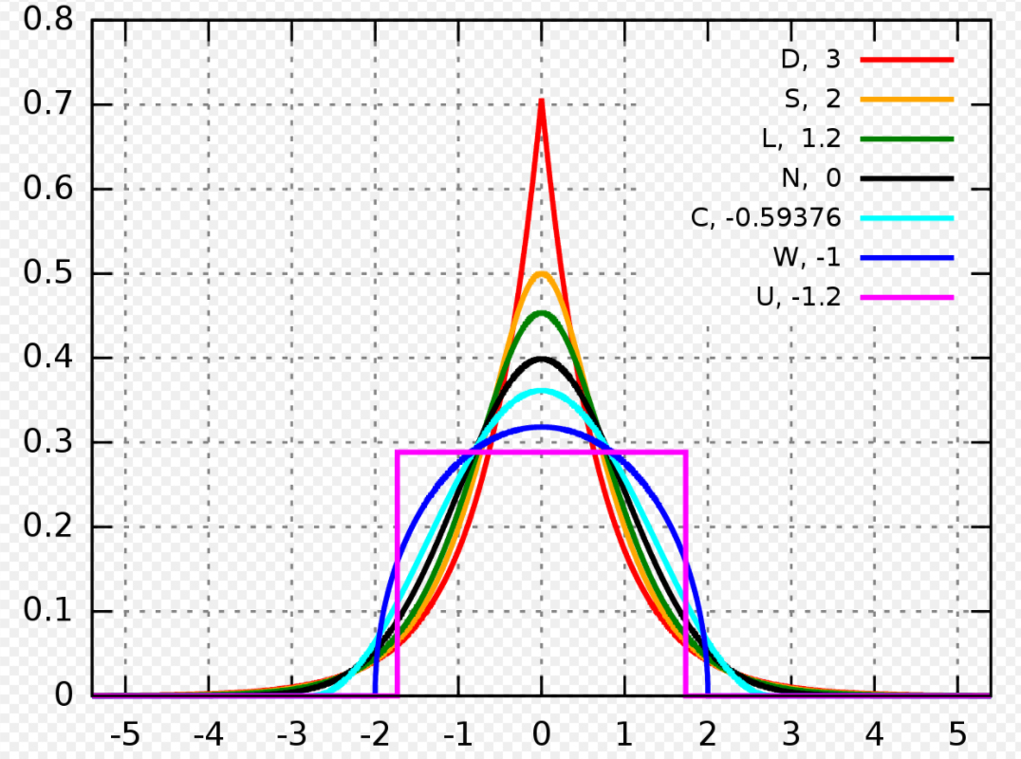
Well-known Kurtosis Curves and Kurtosis values

Slide 15
Well-known Kurtosis values
D: Laplace distribution, also known as the double exponential distribution, red curve (two straight lines in the log-scale plot), excess kurtosis = 3
S: hyperbolic secant distribution, orange curve, excess kurtosis = 2
L: logistic distribution, green curve, excess kurtosis = 1.2
N: normal distribution, black curve (inverted parabola in the log-scale plot), excess kurtosis = 0
C: raised cosine distribution, cyan curve, excess kurtosis = −0.593762
W: Wigner semicircle distribution, blue curve, excess kurtosis = −1
U: uniform distribution, magenta curve (shown for clarity as a rectangle in both images), excess kurtosis = −1.2.

Slide 16
Kernel Density Estimation
Kernel density estimation is a technique for estimation of probability density function that is a must-have enabling the user to better analyze the studied probability distribution than when using a traditional histogram.
In statistics, kernel density estimation (KDE) is a non-parametric way to estimate the probability density function of a random variable. Kernel density estimation is a fundamental data smoothing problem where inferences about the population are made, based on a finite data sample.

Slide 17
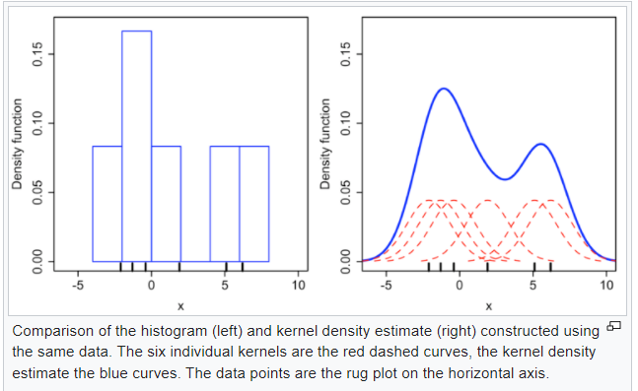
Kernel Density Estimation (KDE)

Slide 18
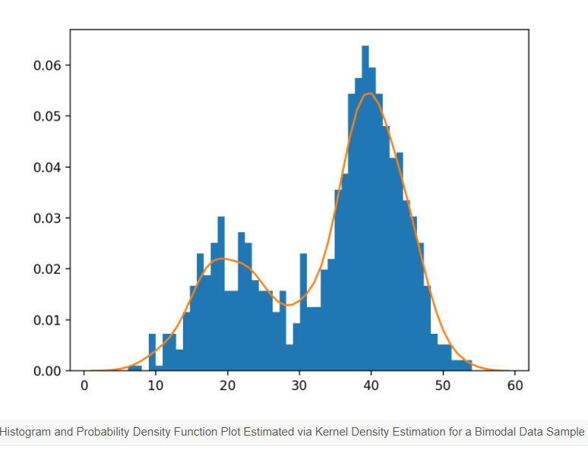
Kernel Density Graph Example

Slide 19
PROBABILITY

Slide 20


Probability – An Introduction
Probability to get 2 = 1/6
Probability to get either 2 or 4 = 2/6
Probability of get 2 and 4 = 0/6=0
Probability to get head = ½ = 0.5

Slide 21

Simple Probability
Find the probability of pulling a yellow marble from a bag with 3 yellow, 2 pink and 2 blue marble
Ans: 3/7

Slide 22
Simple Probability
We have a bag of 9 pink marbles, 2 blue marbles and 3 yellow marbles in it. What is the probability of randomly selecting a non-blue marble from the bag?
Ans: 12/14 = 6/7

Slide 23

Simple Probability
If a number is randomly chosen from the following list, what is the probability that the number is a multiple of 5?
34, 51, 55, 32, 35, 34, 56, 55, 50, 30, 45, 3, 23, 25
Ans: 7/14 = ½= 0.5

Slide 24
Simple Probability
The circumference if a circle is 42Pi. Contained in that circle is a smaller circle with the area of 24Pi. A point is selected at random from inside the larger circle. What is the probability that the point also lies in the smaller circle?
Circumference = 2pi r = 42 Pi
R = 42/2 =21 (Radius)
Area of bigger Circle = Pi *r * r = 21*21 *pi
The probability that the point also lies in the smaller circle
= 24 pi / (21 * 21 * pi ) = 24/441 =0.054
Ans: 0.054

Slide 25
Probability
What is the maximum and minimum probability?
P(rolling <=2) = 2/6
P(rolling >=4) = 3/6
P(rolling>6) = 0/6 = 0
P(rolling any number 1 to 6) = 6/6 = 1

Slide 26
Probability – With Counting Outcomes
Find the probability of flipping exactly two heads on three coins?
Possible Outcomes
HHH
HHT
HTH
HTT
THH
THT
TTH
TTT
Ans : 3/8

Slide 27
Probability – Die rolling
Find the probability of rolling doubles on two six sided dice numbered from 1 to 6?
Expected result : (1,1) (2,2) (3,3) (4,4) (5,5) (6,6)
Total outcomes = 36
Ans : 6/36 = 1/6

Slide 28

Subsets of sample spaces
Amit is at Honda showroom and wanted to purchase a new car.
The types of cars available are City, Civic, WRV and BRV. The colors are Silver, Golden, White, Black and Red.
Based on the sample space of possible outcomes listed below, what is more likely?
The Car that Amit will select is City or Golden color? Ans: 8/20 = 2/5
The Car that Amit will select is City and Golden color? Ans: 1/20
 | Silver | Golden | White | Black | Red
City | City Silver | City Golden | City White | City Black | City Red
Civic | Civic Silver | Civic Golden | Civic White | Civic Black | Civic Red
WRV | WRV Silver | WRV Golden | WRV White | WRV Black | WRV Red
BRV | BRV Silver | BRV Golden | BRV White | BRV Black | BRV Red

Slide 29


Intersection and Union of sets
X = {3,12,5,13}
Y = {14,15,6,3}
$$X ∩ Y=\{3\}$$
$X ∪ Y$= {3,12,5,13,14,15,6}

Slide 30



Relative Complement or Difference between sets
X = {5, 3, 17, 12, 19}
Y = {17, 19, 6}
$X − Y$= {5,3,12}
$Y −X$={6}
$X −X$= {}

Slide 31

Universal Set and Absolute complement
U
A
$$A^{′}=U−A$$

Slide 32



Subset, Strict, Subset and Superset
$$A=\{1,3,5,7,18\}$$
B is a subset of A
B is a strict subset of A
A is a superset of B
C is not a subset of A
$$B=\{1,7,18\}$$
$$C=\left\{18,7,1,19\right\}$$

Slide 33


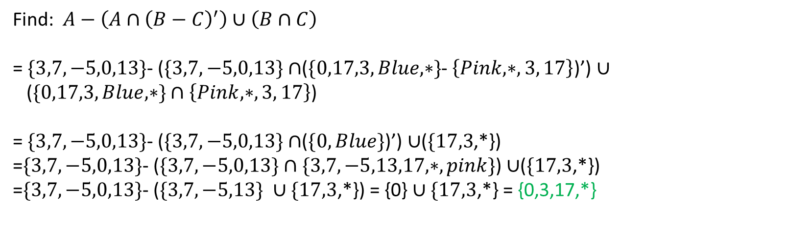

Set Operations together
$$A=\{3,7,−5,0,13\}$$
$$B=\{0,17,3,Blue, ∗\}$$
$$C=\left\{Pink, ∗, 3, 17\right\}$$
Find:$A−\left(A∩{\left(B−C\right)}^{′}\right)∪\left(B∩C\right)$
= $\{3,7,−5,0,13\}$- ($\{3,7,−5,0,13\}$ $∩$($\{0,17,3,Blue, ∗\}$- $\left\{Pink, ∗, 3, 17\right\}$)’) $∪$
($\{0,17,3,Blue, ∗\}$ $∩$ $\left\{Pink, ∗, 3, 17\right\}$)
= $\{3,7,−5,0,13\}$- ($\{3,7,−5,0,13\}$ $∩$($\{0,Blue\}$)’) $∪$($\{17,3$,*})
=$\{3,7,−5,0,13\}$- ($\{3,7,−5,0,13\}$ $∩\{3,7,−5,13,17,∗,pink\}$) $∪$($\{17,3$,*})
=$\{3,7,−5,0,13\}$- ($\{3,7,−5,13\}$ $∪\{17,3$,*}) = {0} $∪\{17,3$,*} = {0,3,17,*}

Slide 34
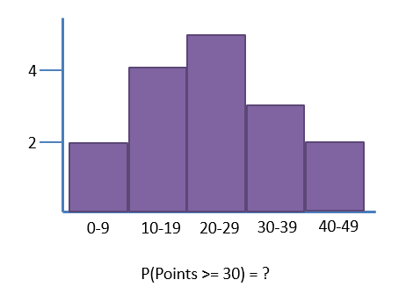


Experimental Probability
Theoretical Probability
Experimental Probability

Slide 35
Experimental Probability
What is the probability of getting red marble if there are 50 green marbles and 50 red marbles in the bucket?
Ans: 1/2

Slide 36
Statistical Significance of the Experiment
In an experiment aimed at studying the effect of advertising on eating behavior in children, a group of 500 children
6 to 12 years old, were randomly assigned to two different groups. After randomization, each child was asked to watch
a cartoon in a private room, containing a large bowl of popcorn. The cartoon included 2 commercial breaks.
The first group watched food commercials, while the second group watched non-food commercials. Once the child
finished watching the cartoon, the conductors of the experiment weighed the crackers bowl to measure how many
grams of popcorn the child ate. They found that the mean amount of popcorn eaten by the children who watched
food commercials are 5 grams greater than the mean amount of crackers eaten by the children who watched non-food
commercials.
They re-randomized the results into two new groups and measured the difference between the means of the new
groups. They repeated this 55 times and plotted the resulting differences as shown in the image.
According to the multiple experiments, is the result of the experiment significant?

Slide 37
There are 55 experiments conducted, The graphs below show the difference between population 1 –population 2. Only in one case, we can see population 1 has a value 5 more than population 2. That means the probability is 1/56. We assume this value got changed if at least 5 % of the time we get a difference of more than 5. ie 5 % of 55 is apprx 3, ie if we get at least 3 times 5 or more then it is statistically significant
-5 -4 -3 -2 -1 0 1 2 3 4 5

Slide 38

Probability with Venn Diagrams
Total Cards: 52
A, 2, 3, 4, 5, 6, 7, 8, 9, 10, J, K, Q
P(Jack) = 4/52
P(Hearts) = 13/52
P(Jack and Hearts)= 1/52
P(Jack or Heart)= 4/52 +13/52-1/52 = 16/52

Slide 39

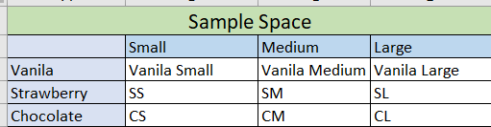
Sample Space for compound space
Cake with three flavors (Vanilla, Strawberry, Chocolate)
and three sizes (small, medium, Large)
Sample Space – All possible outcomes

Slide 40
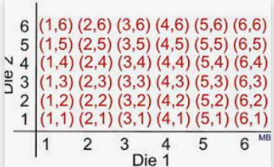
Compound Space
When dealing with probability, every experiment has a set of possible outcomes, called the sample space. If an event has more than one possible outcome, the event is called a compound event.
A compound event in math involves finding the probability of more than one event occurring at the same time.

Slide 41
Compound probability of independent events
Flip Three Coins. The possible outcomes are
HHH
HHT
HTH
HTT
THH
THT
TTH
TTT
Probability of HHH = ½ * ½ * ½ = 1/8
Probability of THT= ½ * ½ * ½ = 1/8

Slide 42


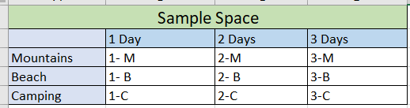

Probability of a compound event
Three-holiday options - Mountains, Beach, Camping
The holiday can be One day, two days, three days
P(Not Mountain and at least 2 days) = 4/9

Slide 43
Coin flipping probability
Tossing a coin 3 times
P(At least 1 Head on 3 flips) = 1-P(TTT) = 7/8
P(At least 1 Head on 10 flips) = 1-P(All tails)
= 1- 1/ 1024
= 1023/1024

Slide 44
Probability without equally likely events
NOT EQUALLY LIKELY OUTCOMES
When a sample space consists of outcomes that don’t have an equal chance of occurrence, then the resultant outcomes are said to be not equally likely outcomes.
EXAMPLES OF NOT EQUALLY LIKELY OUTCOMES
A matchbox has six “6” faces, but all the faces are not equally likely. Therefore, the probability of occurrence of each face varies. Each face has a different occurring value.
A bag is full of balls having different colours and sizes. Now pick up a ball randomly from the bag. The probability of all the balls will not be the same. The probability of occurrence of each ball will vary.

Slide 45
Probability without equally likely events
Consider you are flipping a biased coin with a probability of head 0.6 and tail 0.4
P (H ) = 0.6
P (T) =0.4
P(HH) = 0.6*0.6
P(THT)=0.4*0.6*0.4

Slide 46
Independent events - Exam
On a multiple-choice test, question 1 has 4 choices and question 2 has 3 choices. Each problem has only one correct answer. What is the probability of randomly guessing the correct answer to both questions?
Probability of First question correct Answer = ¼
Probability of Second question correct Answer = 1/3
Randomly guessing the correct answer to both questions = ¼ * 1/3 = 1/12

Slide 47
Die rolling probability with independent events
Find the probability of rolling even numbers three times, using a six-sided die numbered from 1 to 6
Probability of rolling even numbers = 3/6 = 1/2
Probability of rolling even numbers three times = ½ * ½ * ½ = 1/8

Slide 48

Dependent Probability Introduction

Slide 49
Dependent Probability: Coins
You have 8 coins in a bag. 3 of them are unfair in that and they have 60% chance of coming up heads when flipped. You randomly choose one coin from the bag and flip it 2 times. What is the percentage probability of getting 2 heads?
5/8 (Fair coins) – P(HH|Fair) = 0.5*0.5 = 0.25*5/8
3/8 (Unfair coins) – P(HH|Unfair) = 0.6*0.6 = 0.36*3/8
0.25*5/8+0.36*3/8

Slide 50
Dependent Probability: Coins
You have 4 coins in a bag. 3 of them are unfair in that and they have 45% chance of coming up tails when flipped. You randomly choose one coin from the bag and flip it 4 times. What is the percentage probability of getting 4 heads?

Slide 51
Dependent Probability
Suppose Amit simultaneously rolls a six sided die and a four sided die. Let A be the even that he rolls doubles and B is the event that the four sided dis is 4. Use the sample space of possible outcomes shown to answer the following.
What is P(A), the probability that Amit rolls double?
What is P(B), the probability that the four sided die is 4?
What is P(A|B), the probability that Amit rolls doubles, given that the four-sided die is 4?
What is P(B|A), the probability that the four sided die is 4, given that Amit rolls doubles?
What is P(A and B), the probability that Amit rolls doubles and the second die is 4?
What is P(A).P(B|A)?
What is P(B).P(A|B)?
P(A)=1/6
P(B)=¼
P(A|B)=1/6
P(B|A) = ¼
P(A and B) = 1/6*1/4
P(A)P(B|A)=1/6*1/4
P(B)P(A|B)=1/4*1/6
P(A and B) = P(A)P(B|A)=P(B)P(A|B)
P(A)P(B|A)=P(B)P(A|B)

Slide 52


Conditional Probability
Rahul’s two favorite foods are burger and pizza. Let A represent the event that he eats a burger for breakfast and B represents the event that he eats pizza for lunch.
On a randomly selected day, the probability that Rahul will eat a burger for breakfast, P(A) is 0.6, the probability that he will eat pizza for lunch, P(B), is equal to 0.5, and the conditional probability that he eats a burger for breakfast, given that he eats pizza for lunch, P(A|B) is equal to 0.7.
Based on this information, what is the P(B|A), the conditional probability that Rahul eats pizza for lunch, given that he eats a burger for breakfast, rounded to nearest hundredth.

Slide 53

Conditional Probability tree diagram
A company screens job applicants for illegal drug use at a certain stage in their hiring process. The specific test they use has a false positive rate of 2% and a false negate rate of 1%. Suppose that 5% of all their applicants are actually using illegal drugs, and we randomly select an applicant.
Given the applicant tests positive, what is the probability that they are actually on drugs?

Slide 54





Conditional Probability and Independence
John is interested in the weather conditions and whether the downtown train he sometimes takes runs on time. For a year, John records whether each day is sunny, cloudy, rainy or snowy, as well as whether this train arrives on time or is delayed. His results are displayed in the table below:
For these days, are the events “Delayed” and “Snowy” independent?
 | On Time | Delayed | Total
Sunny | 167 | 3 | 170
Cloudy | 115 | 5 | 120
Rainy | 40 | 15 | 55
Snowy | 8 | 12 | 20
Total | 330 | 35 | 365

